Slide 1
Final Presentation
Group 9
Presented by,
Moustapha Sy Dieng (mxd152830)
Trung Hieu Tran (txt171930)
Ponmalar Silambaram Chandrabose (pxs162030)

Slide 2
Project Setup
We opted to use the following configuration:
IDE: Eclipse Oxygen
Java version: JDK 1.8
Build system: Apache Maven 3.5.3
Version control: GitHub

Slide 3
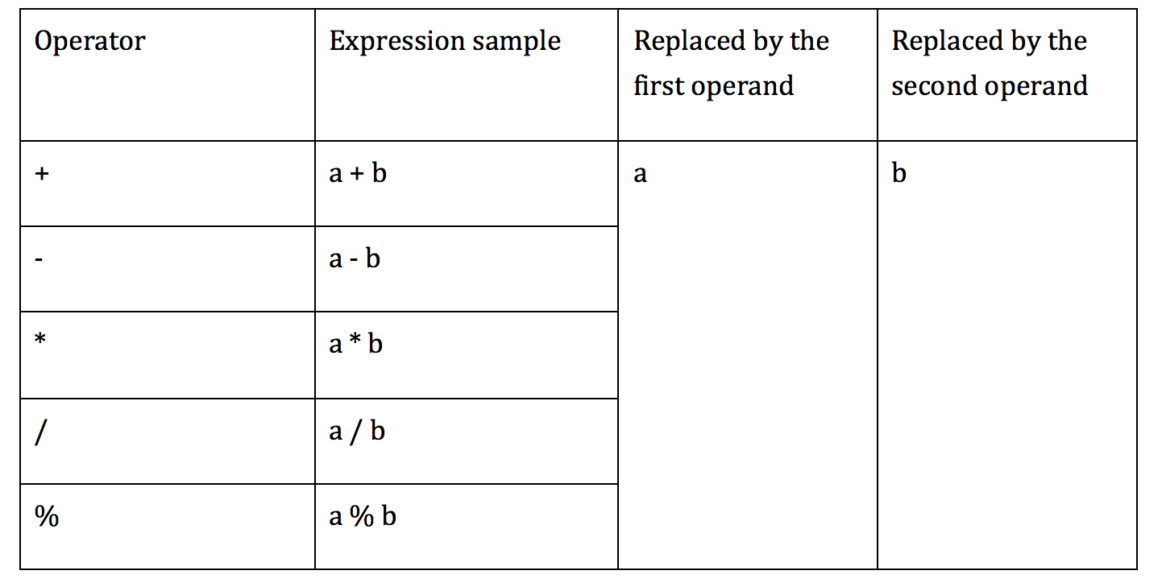
AOD implementation
AOD is replaces an arithmetic expression by each one of the operand

Slide 4
AOR implementation
AOR replaces every arithmetic operator with every other operator.
All the possible replacements:
+ | - | * | / | %
- | * | / | % | +
* | / | % | + | -
/ | % | + | - | *
% | + | - | * | /
Bitwise OR | Bitwise AND | Bitwise XOR
Bitwise AND | Bitwise OR | Bitwise AND
Shift Left | Shift Right | Unsigned Shift Right
Shift Right | Shift Left | Unsigned Shift Left

Slide 5
ROR Implementation
The implementation of the relational operator replacement required for each relational operator to be replaced by every other one.
We used the same approach as the mutators dealing with relational operators such as Conditional Boundary Mutator.
== | != | >= | > | <= | <
!= | >= | > | <= | < | ==
>= | > | <= | < | == | !=
> | <= | < | == | != | >=
<= | < | == | != | >= | >
< | == | != | >= | > | <=

Slide 6
Mutators
CRMutator.MutantType.ADD
CRMutator.MutantType.SUB
CRMutator.MutantType.NEGATE
CRMutator.MutantType.REPLACE_ONE
CRMutator.MutantType.REPLACE_ZERO
AODMutator.AODMutator1.AOD_MUTATOR
AODMutator.AODMutator2.AOD_MUTATOR
RORMutator.Type.NE
RORMutator.Type.EQ
RORMutator.Type.GE
RORMutator.Type.GT

Slide 7
Mutators (contd)
RORMutator.Type.LE
RORMutator.Type.LT
AORMutator.MathMutator1.AOR_MUTATOR
AORMutator.MathMutator2.AOR_MUTATOR
AORMutator.MathMutator3.AOR_MUTATOR
AORMutator.MathMutator4.AOR_MUTATOR
UORMutator.Type.DECREMENT
UORMutator.Type.INCREMENT
UORMutator.Type.REMOVE
UORMutator.Type.REVERSE

Slide 8
CR Mutator
Mutation operator | Expression | Mutant
CRMutator.MutantType.ADD | X | X + 1
CRMutator.MutantType.SUB | X | X - 1
CRMutator.MutantType.NEGATE | X | -X
CRMutator.MutantType.REPLACE_ONE | X | 1
CRMutator.MutantType.REPLACE_ZERO | X | 0

Slide 9
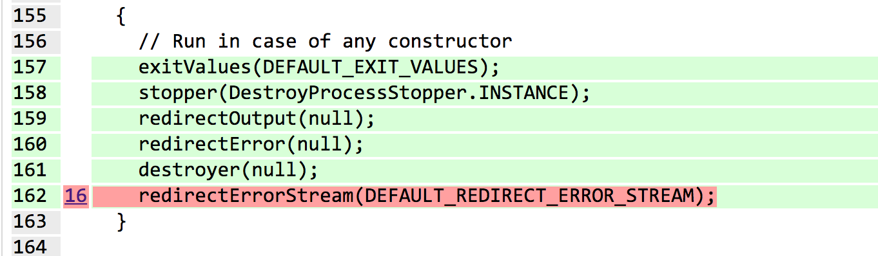
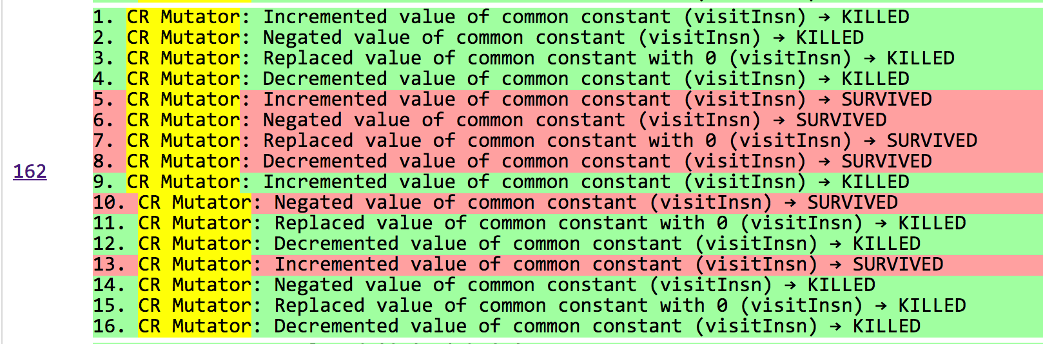
Example in real-world project:
Project: zt-exec
Commit: 305172eaed27aa71a6f4de970d20c73cefe6291e

Slide 10
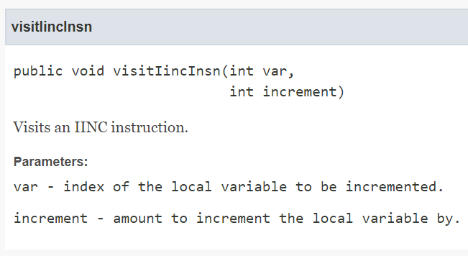
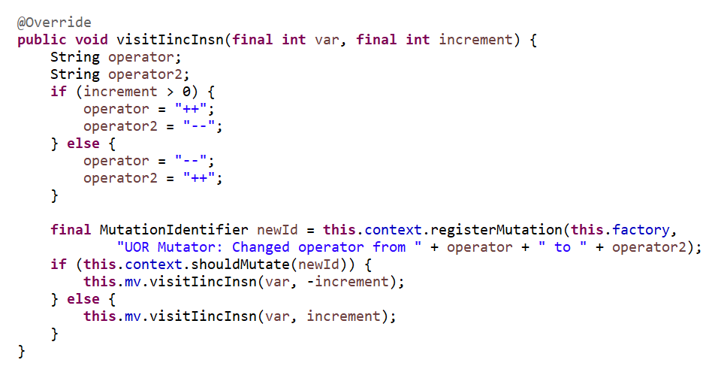
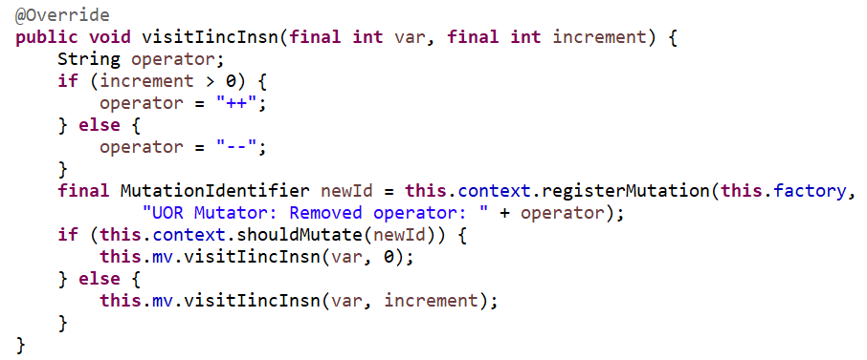
UOR Mutator
Unary Operator Replacement:
Decrement
Increment
Remove
Reverse

Slide 11
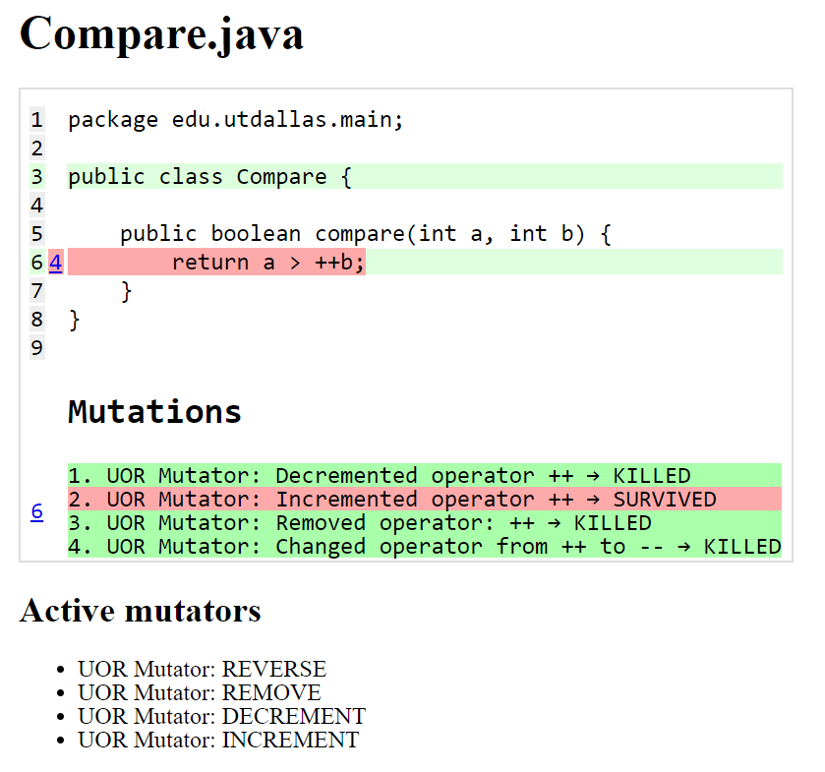
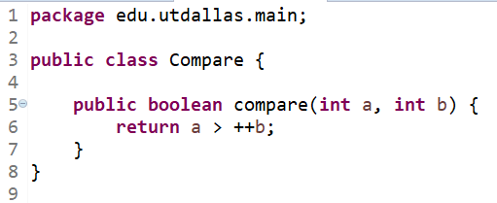
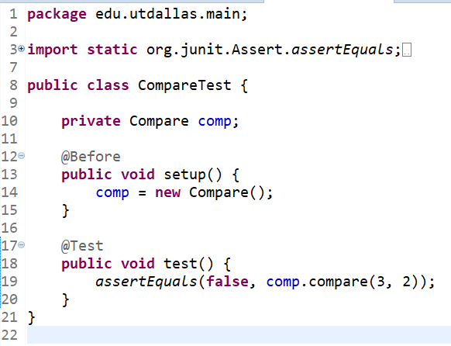
UOR Mutator - Example

Slide 12
Running in MultiThreads
By defult (1 thread):
mvn org.pitest:pitest-maven:mutationCoverage
By n-Threads:
mvn –T n org.pitest:pitest-maven:mutationCoverage
Where, n denotes number of the thread
Example for 4 threads:
mvn -T 4 org.pitest:pitest-maven:mutationCoverage

Slide 13
Test results
Project | Number of Class | Line Coverage |  | Mutation Coverage |  | Running Time | Number of Threads
 |  | percentage | coverage line | percentage | killed/numberOfMutation
zt-exec,305172eaed27aa71a6f4de970d20c73cefe6291e,https://github.com/zeroturnaround/zt-exec | 13 | 59% | 404/689 | 29% | 202/699 | 18:16 min | 4
aho-corasick,25eeef5168846d50dc343c1f224a24745f925f5b,https://github.com/robert-bor/aho-corasick | 12 | 94% | 322/341 | 70% | 481/686 | 0:46 min | 4
GoogleAuth,7051a9a23913c9ef3808467b1c647cab7ada82cf,https://github.com/wstrange/GoogleAuth | 4 | 73% | 187/256 | 50% | 286/576 | 02:54 min | 4
RestFixture,bb4c7071c4edfd9f4aac8c6dd3aee1b196ffa0f1,https://github.com/smartrics/RestFixture | 28 | 78% | 1290/1655 | 53% | 806/1513 | 02:08 min | 4
pollexor,0255b9bbd0163dc2e3c86b3bfc9127ecf3a01cfc,https://github.com/square/pollexor | 3 | 90% | 262/292 | 80% | 756/945 | 0:38 min | 4
rtree,e406cff766740b117898d6777c094ed494220fa5,https://github.com/davidmoten/rtree | 71 | 80% | 1868/2349 | 66% | 1243/1874 | 36:16 min | 4
Project given by TA
commons-codec | 51 | 92% | 3592/3906 | 78% | 14955/19122 | 18:24 min | 4
commons-lang | 106 | 95% | 13894/14563 | 73% | 35563/48766 | 02:23 h | 4
jfreechart | Got crash after running more than 2 hours |  |  |  |  |  | 4
joda-time |  |  |  |  |  |  | 4

Slide 14
Thank you!

